Slide 1

Leading Causes of Death (1900 – 2015)
Steve Bogdan, Dan Fox, Brian Reyes

Slide 2
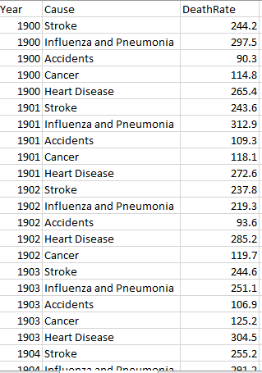
Data
Centers for Disease Control and Prevention
Visualize 5 major causes of death in the United States from 1900-2015.
Stroke, heart disease, influenza/pneumonia, cancer, and accidents.
Dataset link: https://data.cdc.gov/NCHS/NCHS-Age-adjusted-Death-Rates-for-Selected-Major-C/6rkc-nb2q/data

Slide 3
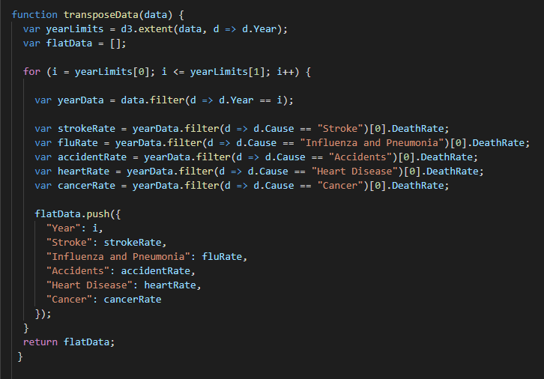
Data Transformation

Slide 4
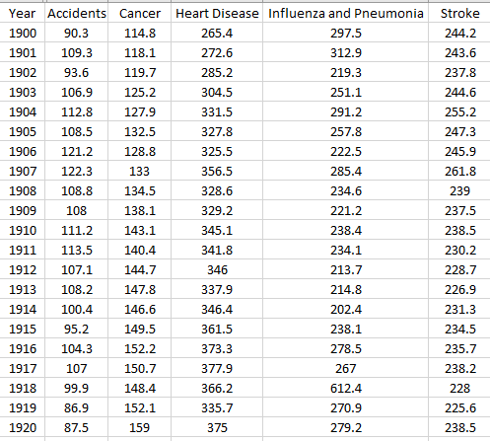
Data Transform Output

